Slide 1

Practical
Test Driven Development
Refactoring your applications towards testing

Slide 2


Who is Tim Rayburn?
Principal Consultant with Improving Enterprises
Organizer of Dallas TechFest
Blogger
Gamer
Troublemaker

Slide 3

Expectations of the audience
You are familiar with:
  Test Driven Development
  Dependency Injection
  Inversion of Control
  Mocking

Slide 4
Quick Review : TDD
Test Driven Development
  The practice of writing automated unit tests which exercise just the code you are writing without concern for its place in your system.
  Focuses development first on how a component will be consumed through the practice of Test First.
  Small iterative cycles : Red, Green, Refactor

Slide 5
Quick Review : DI
Dependency Injection
  The practice of allowing classes which you depend on for functionality to be “injected” into your class.
  The most common forms of injection are constructor and property injection.
  By injecting dependencies, when testing you can replace actual dependencies with Mocks.

Slide 6
Quick Review : IoC
Inversion of Control Containers
  Component which handles construction of instances which have large numbers of dependent classes.
  There are many containers available, most are open source. Popular frameworks include : Castle Windsor, Ninject, Structuremap, and others.
  Usually IoC is mapping Interfaces to Concrete classes in the process of construction.

Slide 7
Quick Review : Mocking
Mocking
  The practice of replacing dependencies with stub implementations which satisfy the needs of one or more tests.
  There are many mocking frameworks, but one of these is far more popular than the rest, Rhino.Mocks.
  Rhino.Mocks makes it very easy to mock an interface.

Slide 8

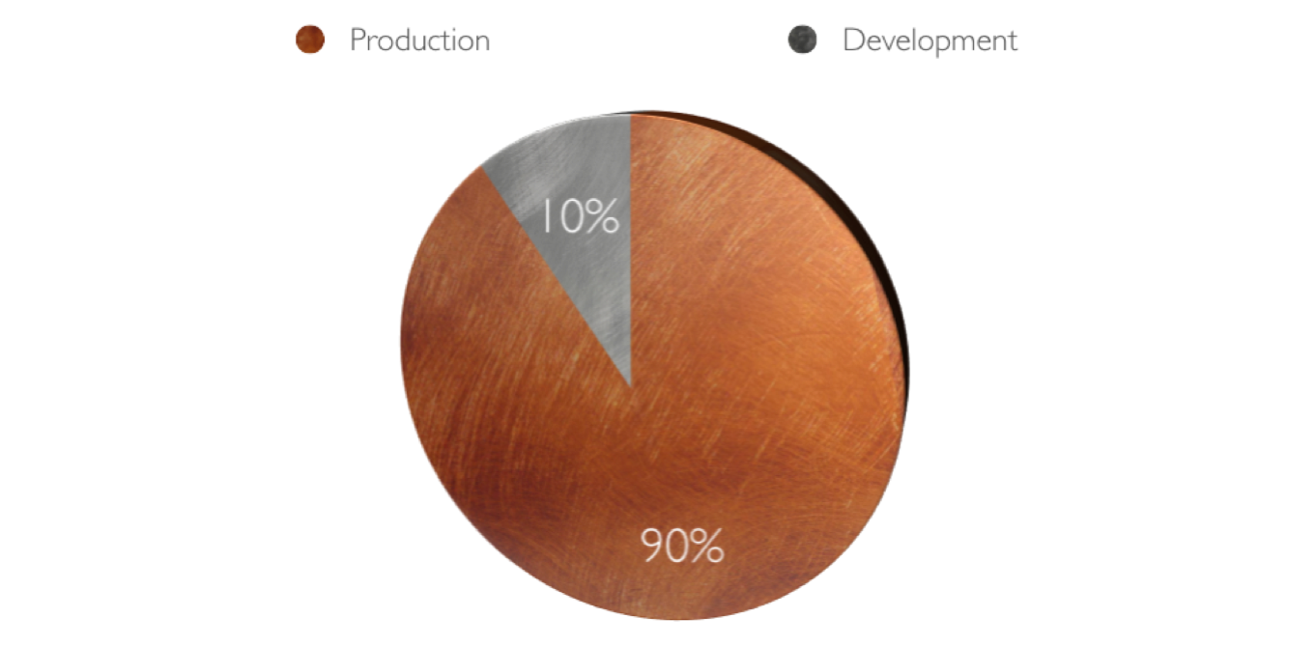
Your App’s Lifetime

Slide 9

Most Problems Relate To...
Technology
Process
People
Character

Slide 11
Test First is Hard
The Problem
We want to follow best practices, which would mean Red, Green, Refactor.
Unfortunately that is very different from the normal workflow.

Slide 12
Test First Is Hard
A Solution
Suck it up!
Consider using the Given/When/Then structure for your tests.

Slide 13
Test First Is Hard
Demo

Slide 14
No IoC Container
The Problem
Most TDD talks assume that you have a simple, container driven approach.
Existing projects rarely already have IoC containers.
We want to enable Dependency Injection without requiring a total refactoring of every class.
We’d prefer if once we have incrementally reached a proper level of inject-ability that we are not stuck with remnants.

Slide 15
No IoC Container
A Solution
We can reach all of the desired by wisely using the Service Locator pattern.
Service Locator can get a bad reputation from purists, because they feel so strongly about inject-ability.
Our solution will use constructor injection, and constructor overloading.

Slide 16
No IoC Container
Demo

Slide 17
Huge Backlog
The Problem
To create tests that cover the whole of our already developed application.
Contrary to Test First but necessary because that ship has sailed.

Slide 18
Huge Backlog
A Solution
You break it, you bought it.
  A philosophy that is useful on teams with this problem which states that if your current feature requires you to modify a method, then you are responsible for creating at least one “happy path” test for that method.
  If and only if there are no reasonable “happy path” tests still to be written, then you can write an exception case.
  If none of those exist, congratulations it is a tested class.

Slide 19
Huge Backlog
Are you nuts Tim?

Slide 20
Dependencies
The Problem
A class has a huge number of dependencies, some of which we have no control over.
The class is amazingly poorly factored, and is likely violating multiple of the SOLID principles.
You break it, you bought it is not going to work on this 5,000 line method.
Yet we want to add functionality to it which is tested.

Slide 21
Dependencies
A Solution
First, as painful as it may be, seriously consider re-writing this class, breaking it down into reasonably factored classes each of which has a Single Responsibility.
Failing that, create a new class which encapsulates only the desired change, and then inject that class into the monster class.
Call out to this class at the appropriate places in the monster class.

Slide 22
Dependencies
Demo

Slide 23
Static
The Problem
My product is littered with static methods, static types, and static everything.
You can’t apply interfaces to static, so all these polymorphic tricks used in TDD don’t net me any testability.

Slide 24
STATIC
A Solution
First, as painful as it may be, seriously consider re-writing this class, breaking it down into reasonably factored classes each of which has a Single Responsibility.
Failing that, create a new class which encapsulates only the desired change, and then inject that class into the monster class.
Call out to this class at the appropriate places in the monster class.

Slide 25
STATIC
TypeMock
Isolator

Slide 26

Questions?
tim@timrayburn.net
timrayburn.net

